Slide 1


“Advanced C Programming”
eDESD-2021
Notes:
DSBDA-2015

Slide 2
GNU toolchain
The GNU toolchain is a broad collection of programming tools produced by the GNU Project.
Major components of GNU toolchain are:
GNU make: an automation tool for compilation and build
GNU Compiler Collection (GCC): a suite of compilers for several programming languages
GNU C Library (glibc): core C library including headers, libraries, and dynamic loader
GNU Binutils: a suite of tools including linker, assembler and other tools
GNU m4: an m4 macro processor
GNU Debugger (GDB): a code debugging tool
Source:https://en.wikipedia.org/wiki/GNU_toolchain

Slide 3
GNU make

Slide 4
GNU make
What is a Makefile?
A makefile is a specially formatted text file that a unix/linux program called 'make' can interpret.
Basically, the makefile contains a list of requirements for a program to be 'up to date.’ The make program looks at these requirements, checks the timestamps on all the source-files listed in the makefile, and re-compiles any files which have an out-of-date timestamp.
Source:http://faculty.salisbury.edu/~despickler/personal/Resources/DataStructures/Handouts/makefile-tut.pdf

Slide 5
product.c
#include <stdio.h>
/* Function Prototype */
int product(int n1,int n2);
int main()
{
int num1,num2,p;
printf("Enter a num1:\n");
scanf("%d",&num1);
printf("Enter a num2:\n");
scanf("%d",&num2);
p=product(num1,num2);
printf("prod=%d \n",p);
return 0;
}
/* Function Definition */
int product(int n1, int n2)
{
return n1*n2;
}

Slide 6
Executable generation:
In Single step:
gcc product.c –o product
In two step:
Step1: object file(product.o) generation
gcc -c product.c
Step2: object file to executable
gcc product.o -o product

Slide 7
prod_main.c prod_fun.c
#include <stdio.h>
#include “prod_fun.c” // user def file
/* Function Prototype */
int product(int n1,int n2);
int main()
{
int num1,num2,p;
printf("Enter a num1:\n");
scanf("%d",&num1);
printf("Enter a num2:\n");
scanf("%d",&num2);
p=product(num1,num2);
printf("prod=%d \n",p);
return 0;
}
/* Function Definition */
int product(int n1, int n2)
{
return n1*n2;
}

Slide 8
Executable generation:
gcc prod_main.c -o prod

Slide 9
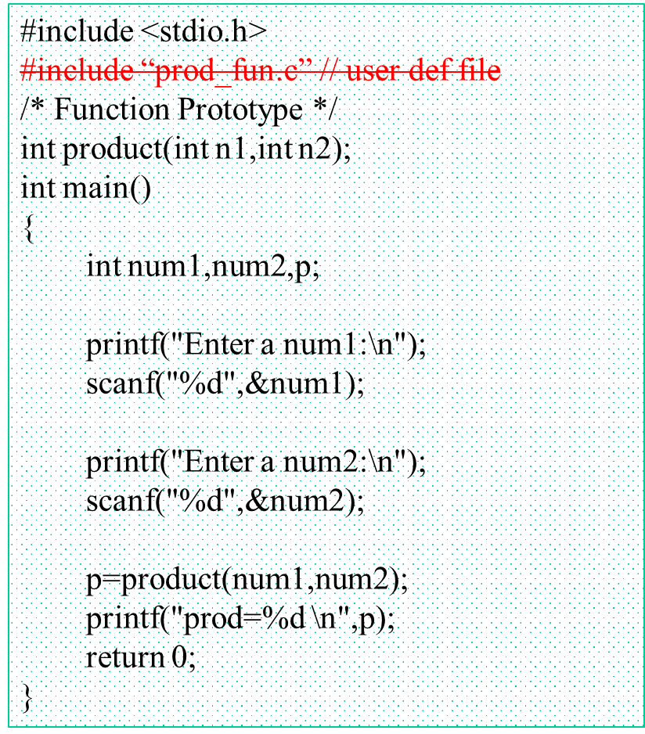
prod_main.c prod_fun.c
/* Function Definition */
int product(int n1, int n2)
{
return n1*n2;
}

Slide 10
Executable generation:
In two step:
Step1: object file(prod_main.o prod_fun.o ) generation
gcc -c prod_main.c
gcc -c prod_fun.c
Step2: object file to executable
gcc prod_main.o prod_fun.o –o prod

Slide 11
Executable generation using Makefile
Target: dependencies
action
-----------------------------------------------------------------------------
prod: prod_main.o prod_fun.o
gcc prod_main.o prod_fun.o -o prod
prod_main.o: prod_main.c
gcc -c prod_main.c
prod_fun.o: prod_fun.c
gcc -c prod_fun.c

Slide 12
area.c prod_fun.c
#include <stdio.h>
/* Function Prototype */
int product(int n1,int n2);
int main()
{
int l,w,area;
printf("Enter length:\n");
scanf("%d",&l);
printf("Enter width:\n");
scanf("%d",&w);
area=product(l,w);
printf("area=%d \n",area);
return 0;
}
/* Function Definition */
int product(int n1, int n2)
{
return n1*n2;
}

Slide 13
Different Executable generation using Makefile
prod: prod_main.o prod_fun.o
gcc prod_main.o prod_fun.o -o prod
prod_main.o: prod_main.c
gcc -c prod_main.c
prod_fun.o: prod_fun.c
gcc -c prod_fun.c
area: area.o prod_fun.o
gcc area.o prod_fun.o -o area
area.o: area.c
gcc -c area.c
Make for prod executable
make prod
Make for area executable
Make area

Slide 14
multiple Executable generation using Makefile
all: prod area
prod: prod_main.o prod_fun.o
gcc prod_main.o prod_fun.o -o prod
prod_main.o: prod_main.c
gcc -c prod_main.c
prod_fun.o: prod_fun.c
gcc -c prod_fun.c
area: area.o prod_fun.o
gcc area.o prod_fun.o -o area
area.o: area.c
gcc -c area.c
clean:
rm *.o prod area
Make for all executables
make all
Removing exe and executable
Make clean

Slide 15
GNU Debugger

Slide 16
GNU Debugger
Compiling step:
gcc [other flags] -g <source files> -o <executable>
Ex: gcc while.c -g -o while

Slide 17
GNU Debugger
Starting command for gdb:
#...... $ gdb executable-file
Ex: gdb while
…
appears gdb prompt as shown below
(gdb)

Slide 18
GNU Debugger
To run the program:
(gdb) run or r
Set break points on particular line number:
(gdb) break while.c:7
(gdb) break 7 (if single file)
To proceed execution to till next breakpoint :
(gdb) continue

Slide 19
GNU Debugger
Set break points on particular line number( using break or b):
(gdb) break while.c:7
(gdb) break 7 (if single file)
(gdb) break function_name
Set break points on specific condition ( using break or b):
(gdb) break code.c:6 if i >= 8
List next lines of code of execution ( using l):
(gdb) l

Slide 20
GNU Debugger
To proceed execution to till next breakpoint :
(gdb) continue
For moving to next instruction in code:
(gdb) next or n .. Next instruction
(gdb) step .. Next step
To check value stored at particular variable:
(gdb) print var_name / p var_name
To watch particular varible for any changes :
(gdb) watch var_name

Slide 21
GNU Debugger
struct employee {
int id;
char name[20];
float salary;
char gender;
};
struct employee emp1;
struct employee *ptr;
emp1.id=1;
strcpy(emp1.name, "Ravi");
emp1.salary = 25234.5;
emp1.gender = 'M';
ptr=&emp1;
(gdb) print var_name / p var_name
(gdb) p ptr
(gdb) p emp1
(gdb) p emp1.id
(gdb) p *ptr
(gdb) p *ptr.a

Slide 22
GNU Debugger
Info about break points ( using break or b):
(gdb) info breakpoints
Delete break points ( using delete):
(gdb) break code.c:6 if i >= 8

